Slide 1
Fundamentals of Microsoft Teams
Build a Microsoft Teams Tab

Slide 2

Build a Microsoft Teams Tab
Overview of building a Microsoft Teams Tab
Tab content and configuration
Interacting with Teams and External Systems
Azure Active Directory and the Microsoft Graph API
DEMO

Slide 3
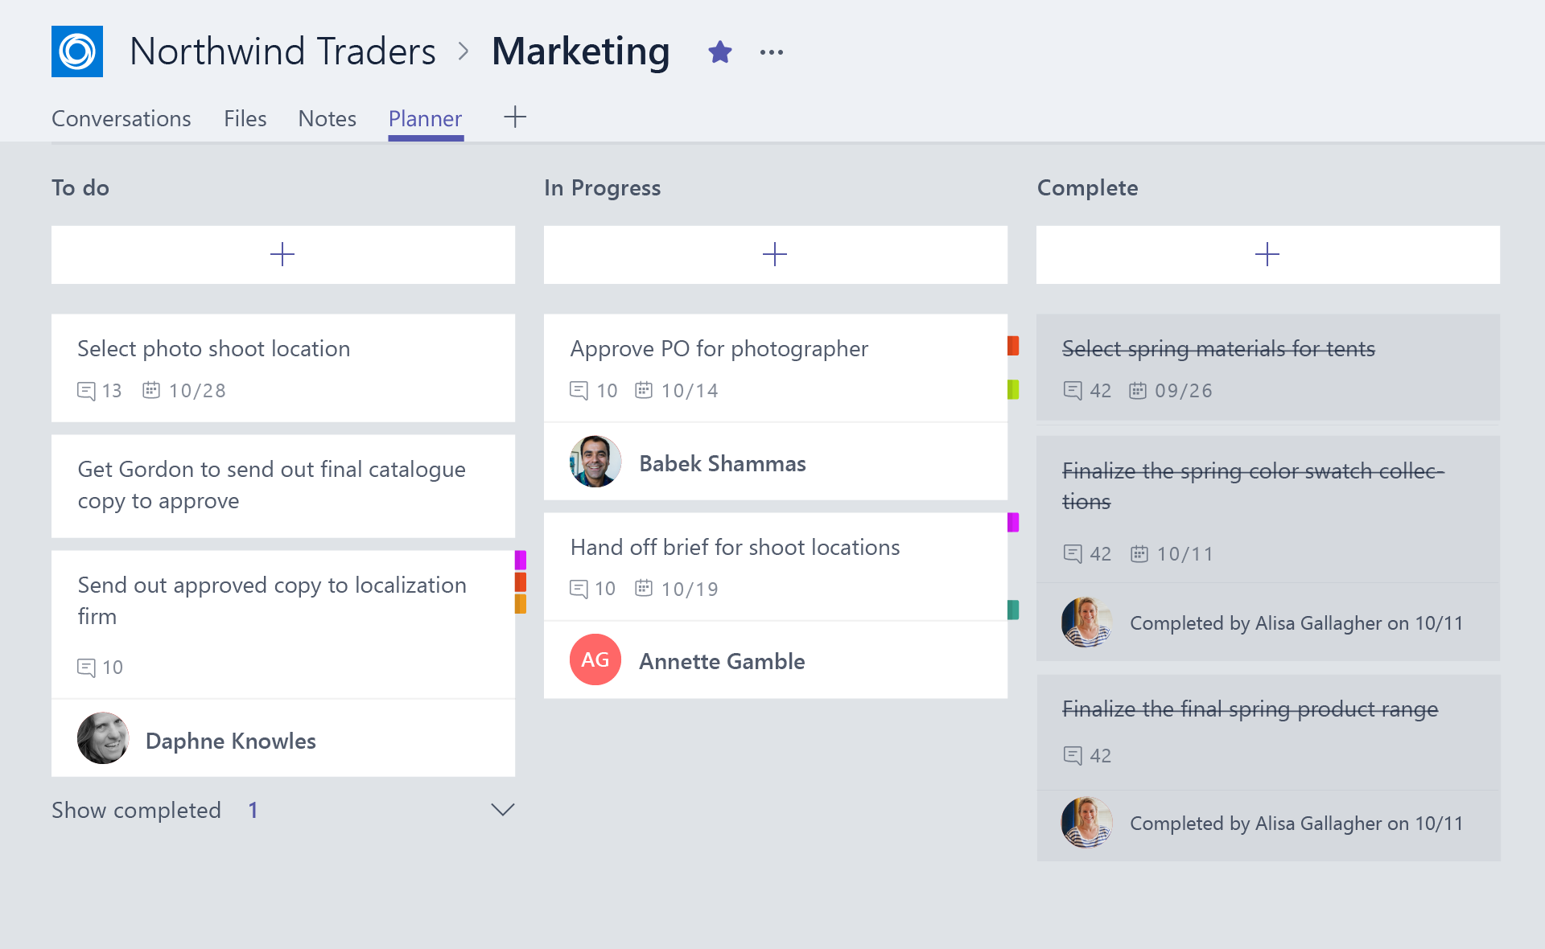
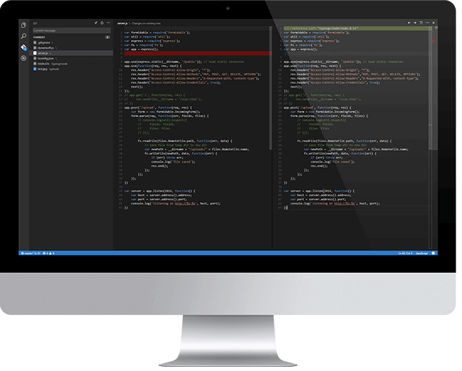
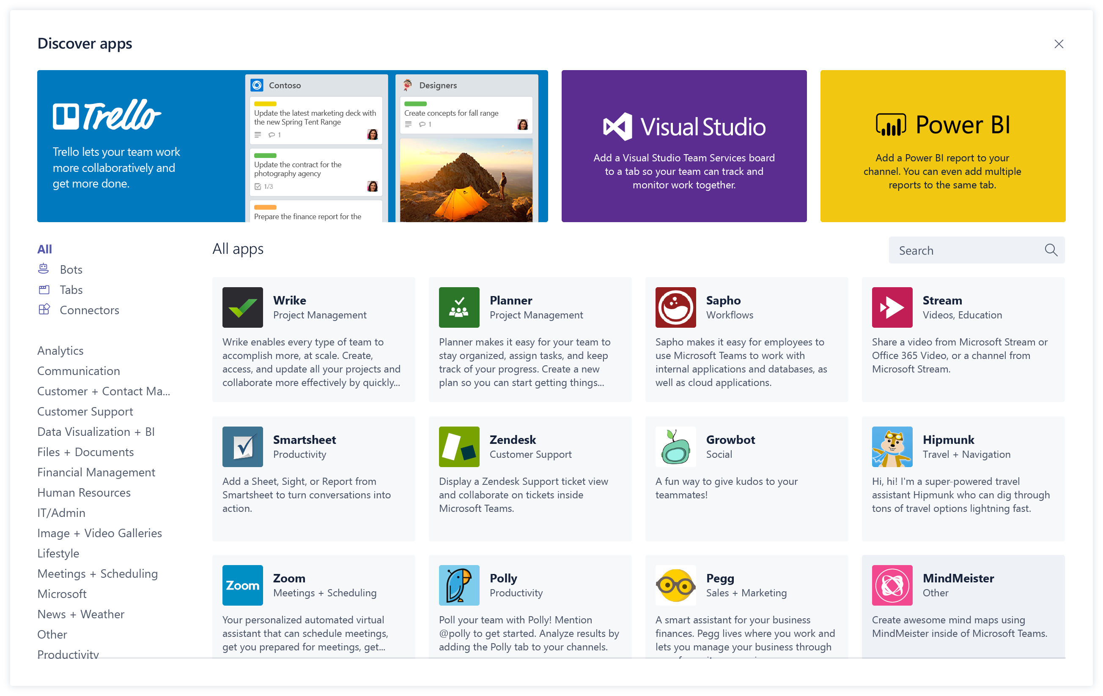
Overview of building a Microsoft Teams Tab
Design a great tab
Select relevant app functionality
Scope and focus the user experience
Integrate and streamline access
Develop your tab
HTML/JavaScript/TypeScript
REST services
Deep Linking and context
Deploy your tab
Upload to Team
Upload to Tenant App Gallery
Submit to Office Store
Notes:
Design
Focused functionality
Tabs work best when they’re built to address a specific need. Focus on a small set of tasks or a subset of data that’s relevant to the channel the tab is in.
Reduced chrome
Avoid creating multiple panels in a tab, adding layers of navigation, or requiring users to scroll both vertically and horizontally in one tab. In other words, try not to have tabs in your tab.
Integration
Find ways to notify users about tab activity by posting cards to a conversation, for example.
Conversational
Find a way to facilitate conversation around a tab. This ensures that conversations center on the content, data, or process at hand.
Streamlined access
Make sure you’re granting access to the right people at the right time. Keeping your sign-in process simple will avoid creating barriers to contribution and collaboration.
Develop
Any editor
Call any service
Deploy
Seller Dashboard is used to submit to store
Not necessary for tabs – can upload

Slide 4
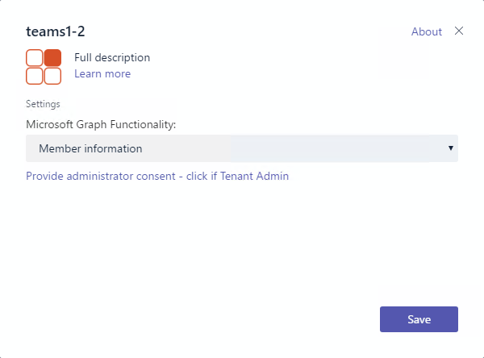
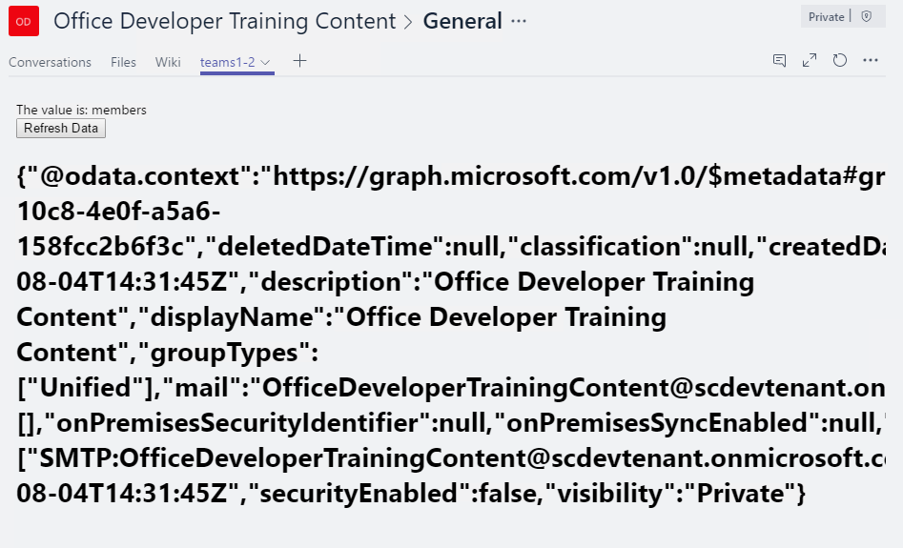
Tab Configuration and Content
Tab Configuration
Configured in manifest
Displayed when Tab added to Channel
Collect information
Call setSettings() specifying Content Url and Entity Id
Tab Content
Rendered in IFRAME
Url specified by configuration page
Inspect context for EntityId/SubEntityId
Retrieve state based on Entity/SubEntity/User
Notes:
To provide a seamless tab experience, perform provisioning and authorization on configuration page when possible.
If context has entity/subentity, then respond to a deeplink
State storage is developer’s responsibility

Slide 5
Interacting with Microsoft Teams
Teams API provides context for User / Team / Organization
Getting Context through URL placeholders
Placeholders specified in URL in manifest
Resolved at runtime
Placeholders for each property of Context object
{upn}, {teamId}
Getting Context through the JavaScript library
Library provides function to get context
microsoftTeams.getContext()
Asynchronous method with only success callback
Returns context object
Noteworth Properties | Description
teamId | The team ID in the format 19:[id]@thread.skype
channelId | The channel ID in the format 19:[id]@thread.skype
Locale | Lowercase lang-locale
theme | default | dark | contrast
entityId | The entity id you set up on your config page
subEntityId | The sub entity id you set up on your config page
upn | The user identifier in email format
tid | Guid identifying the current Tenant ID
groupId | Guid identifying the current O365 Group ID

Slide 6
Interacting with external services
Authenticating
Authentication cannot occur in IFRAME
Teams JavaScript library facilitates popup and cross-window communication microsoftTeams.authentication.authenticate({ url: <auth URL>, width: <width>, height: <height>, successCallback: <successCallback>, failureCallback: <failureCallback>})
In <auth URL> signal result and pass data microsoftTeams.authentication.notifySuccess(token) microsoftTeams.authentication.notifyFailure(err)
Redirecting across domains
Tabs can only show pages in validDomains list of manifest
Call microsoftTeams.navigateCrossDomain(yourNewUrl) to request the IFRAME containing your page is redirected to the specified URL.
(Could also display page in popup via authenticate)

Slide 7
Demo Call Microsoft Graph inside a Tab

Slide 8

Summary

Slide 9
Thank you

